Slide 1
Personalizing SharePoint

Slide 2
Agenda
Keeping Informed
Customizing Your Interface
Finding Important Information
Working Offline

Slide 3
Personalization Can Result In…
Improved Individual Productivity
Reduced Seek Time
Concise Resources
Broadened Work Space
Shorter Reaction Time
Notes:
SharePoint allows business information workers to personalize their experience, thereby providing significant advantages to the manner in which they conduct their duties. By incorporating personalization features into the business user’s SharePoint practices, the company benefits from:
Shorter Reaction Time: business users react quickly to changes in data or to task assignments
Improved Individual Productivity: business users perform better in an interface more suited to the way they think and work
Reduced Seek Time: searches that yield pertinent data quickly help users qualify and utilize data more efficiently
Broadened Work Space: business users can work with mission critical data both online and offline
Concise Resources: less distraction caused by “too much” data that is not germane to the task at hand
The overall goal of personalization is too make SharePoint friendlier for the business user to employ, and thus make them more productive.

Slide 4
Keeping Informed
Alerts
RSS Feeds
Field Notifications
Workflows
Notes:
On any community based platform, when there are multiple contributors to the system it is virtually impossible for a business user to keep up with the various changes being made to the sites during the day. First, it is unreasonable to believe a business user can spend their entire work day engaged with the SharePoint sites via a web browser and second there is no way they could know which sites to visit, and when, to see all of the changes made by other users.
Luckily SharePoint gives us tools for receiving notices when important information has changed:
Alerts
Subscribed to by the business user (or on the user’s behalf by an administrator), Alerts initiate an email or mobile text message to the configured recipient’s email address on file in SharePoint whenever something important has happened. Users must keep their email address and mobile phone number properties on their SharePoint profile updated to avoid missing important alerts.
RSS Feeds
Subscribed to by the business user, RSS Feeds allow the business user to employ their choice of RSS reader from which they can view a streamed channel of item changes being made in a given list or library.
Field Notifications
SharePoint 2010 incorporates a functionality on the Attendee and the Assigned To column that automatically emails the user named in the field upon creation of a new task or item. These email notifications include a hyperlink that takes the user directly to the list item in which they are named.
Workflows
Custom workflows on content types, lists, libraries or items can be configured to send an email as one of their defined actions.

Slide 5
Alerts
User or management initiated
Email or Text delivery
Scoped by site, list/library, folder or item
Qualified by item creation, change or deletion
Summarized by day or week
Notes:
When subscribing to an alert, you (or the manager subscribing for you) must specify which communication method you want the SharePoint 2010 server to use when notifying you about data changes. There are two choices: Email or Text. The Text option refers to mobile device text messaging, which requires other systems be in place and integrated with SharePoint 2010. If the Text option is grayed out it is likely because your Information Technology department has not yet installed an Office Mobile Services solution that allows Microsoft products like SharePoint and Exchange to communicate directly with mobile devices.
Alerts are available on all of the lists and libraries within a site. Which means if the site’s pages are kept in an exposed page library (like the Site Pages library on a wiki site), you could conceivably subscribe to alerts on that library which would notify you about changes to the overall site itself. Subscriptions to list or library alerts are created by choosing the My Settings option of your Welcome menu when visiting the host site and clicking the My Alerts link in the toolbar. Alerts to folders or individual items can created via the View Properties window on that folder or item.
Alerts can be configured to report on new additions to a list, changes made to items in a list (including deletion) or both. The Alert can be further filtered to only notify you in the event that someone other than yourself made the change and/or only if the changes were made on items you created or were the last to modify. Alerts can be summarized so that your inbox doesn’t get overwhelmed with individual emails every time a single change is made on a single item. Summarization can be configured to be sent once a day or once a week . These summarized alerts will contain details about all of the changes made and to which items they occurred throughout the day or week.
NOTE: When it comes to alerts, too much of a good thing can be a bad thing. Be careful to not over-subscribe yourself to the point where you are receiving so many alerts that none stand out as important, thereby defeating the purpose.

Slide 6
DEMO
SharePoint 2010 Alerts
Notes:
In this demonstration, your instructor will illustrate:
How to subscribe to an Alert on a list/library.
How to subscribe to an Alert on a folder or item.
How to select data change type for alert.
How to filter alert by editing user or item created by/modified by fields.
How to summarize alerts.

Slide 7
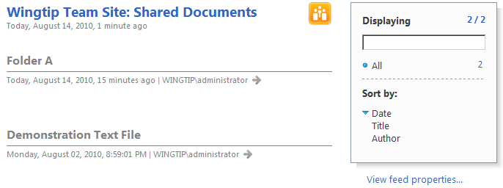
RSS Feeds
Notes:
RSS Feeds are an alternative to Alerts that can serve a similar purpose of letting you know when things have changed on a list or library. And again, since some sites maintain their pages in a page library (like wiki sites) that library can be configured for RSS Feed to keep users notified about changes to the site.
Using RSS Feeds of SharePoint lists and libraries requires you to have a RSS reader application that can consume the feed. SharePoint 2010 offers a RSS Viewer web part for displaying RSS Feeds right on a SharePoint site. Microsoft Office includes a RSS reader in Outlook. And Microsoft Internet Explorer includes a RSS reader. There are also a bevy of RSS readers available on the Internet (some free, some for purchase). The customization options of these readers differ but most allow you to set a refresh rate (sometimes called an update schedule) that conveys how often the reader checks with the feed for new information. The shorter the refresh interval, the closer to “real time” your subscription is in divulging recent changes to the list or library.
Unfortunately, RSS subscriptions do not offer the same filtering options as Alerts. The Feed is dictated by the list/library administrator. If you subscribe to the feed you will receive those columns and details about the items that the administrator deems fit. However, depending on your RSS reader application, you may be able to sort or filter the display of the feed to only expose those items you are most interested in.

Slide 8
DEMO
SharePoint 2010 RSS Feeds
Notes:
In this demonstration, your instructor will illustrate:
How to subscribe to a RSS Feed on a list or library.
How read a RSS Feed on a SharePoint site.
How to read a RSS Feed in Internet Explorer.
How to sort a RSS Feed in Internet Explorer.

Slide 9
Field Notifications
Auto-generated upon task assignment
Auto-generated upon task RE-assignment
Auto-generated for new items in Attendees lists
Contain hyperlink directly to list item
Notes:
SharePoint 2010 is capable of sending automatic email message thanks to the Outbound Email settings maintained by your SharePoint Administrator. This feature is what makes Email Alerts possible (among other things) and is also the foundation of field notification.
When a list is created that incorporates either the Assigned To field or the Attendee field, these fields are filled in with user identities as their content. The user entered, if they have a valid email address profile property value, will receive an email notification from the SharePoint 2010 server upon being chosen as the field entry. For example, a Task list template uses the Assigned To site column to signify who is expected to complete the task. When a new task item is created and the user name is chosen from the People Picker for entry into the Assigned To column, SharePoint automatically emails that user with a message that includes a hyperlink to the task item. If the task is reassigned to another user, the new assignee will receive an email message notifying them that the task has now been assigned to them. Alas, SharePoint does not correspondingly notify the first person tapped for the task that they are no longer responsible for the assignment.
Similarly, a list that contains an Attendee column will expect a user identity to be entered as the value for that column. When you enter a user with a valid email address in their SharePoint profile, the server will automatically email the attendee with a message that includes a hyperlink to the list item that contains their name (preferably the list is on a meeting workspace site that displays further details about the event).

Slide 10
DEMO
SharePoint 2010 Tasks
Notes:
In this demonstration, your instructor will illustrate how a task assignment generates an email notification.

Slide 11
Agenda
Keeping Informed
Customizing Your Interface
Finding Important Information
Working Offline

Slide 12
Customizing Your Interface
Page in Personal View
Personal List Views
Regionalization
Notes:
One benefit of a community platform is the multitude of business data that can be stored in one place and accessible to everyone. But this benefit also can develop into a challenge if too much information is presented that is difficult to sort through. As SharePoint users get more familiar with which sites and specific data benefit their business decisions the most, they can customize their SharePoint interface to best deliver those mission critical resources. SharePoint 2010 gives users the opportunity to personalize individual web pages and list views to better filter the data presented to them.
Personalizing a SharePoint web page is accomplished by selecting personal web parts for the page. These web parts are visible only to the specific user who is logged in and personalizes the page. These web parts can expose volumes of information from both inside and outside SharePoint. Additionally, users can create personal views on lists or libraries that are visible only to their logon. These views can be sorted, filtered and grouped to arrange list items they work with most.
Lastly, users can choose alternative language display of the SharePoint web site if the server has been configured to deliver multi-lingual sites and the user’s web browser is capable of selecting language. This is helpful in multi-national corporations where the user base is distributed across different countries and speak different languages.

Slide 13
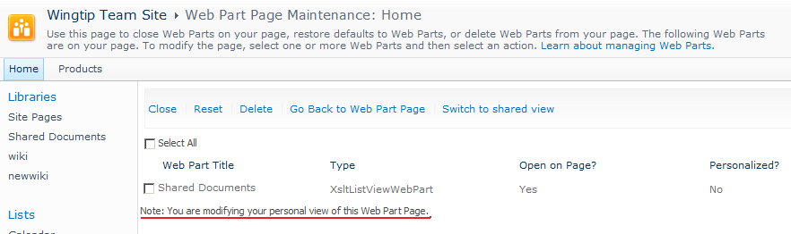
Page in Personal View
Notes:
To modify your view of a SharePoint web part page, you must first visit the web part page in maintenance view. This view allows you to select the web parts you wish to close in your personal view, leaving only the web parts you need. By customizing your view of the page, you can filter out distracting information from your personal view. Any shared web parts you close or delete from your personal view of the page will remain in the shared view of the page. This is important because these shared web parts may contain important business information that, while you do not access it frequently, still bears relative importance to other users of the page.
Once your personal view of a page has been defined, every time you log onto that page in SharePoint you will be presented your Personal View of the page! This can breed confusion among multiple team members if they are communicating about the page and notice the view coming up for their coworker isn’t the same as the view they witness on their own pc. This confusion can become counterproductive and even lead to unnecessary help desk calls. Consider personalization carefully and be careful not to miss out on important announcements because your personal view has closed an imperative web part.

Slide 14
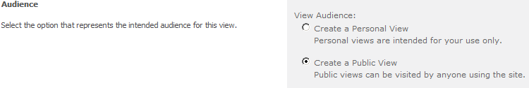
Personal List Views
Creating a Personal View differs little from creating a public view except for the Audience setting.
Notes:
Any business user with the permission to build personal views can construct additional views on a list or library to better suit their productivity. Some list templates provide multiple public views of the list, such as the Calendar and Task list templates. You will want to be sure one of the existing list views does not already serve your purpose before going to the trouble to create a personal view on the list.
Once you determine a personal view is necessary, you must choose the appropriate view type (standard, calendar, Access, datasheet, Gantt, or custom) and be sure to select the Create a Personal View radio button in the Audience section of the view definition. In fact, do not be surprised if the alternative radio button entitled “Create a Public View” is grayed out and unavailable to you. Not all business users are normally granted the necessary permission to create views that can be seen by everyone who visits the list.
With the exception of the public versus personal Audience setting, however, creation of a personal view is no different than creation of a shared view. All of the view properties for sorting, filtering, totaling, grouping, etc. are available in a personal view just like in a public view.

Slide 15
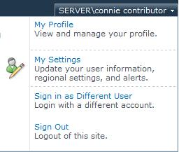
Regionalization
Notes:
Regional settings are available from your personal Welcome menu in SharePoint 2010 and can be used to alter the display of content the web pages you visit in SharePoint. You can specify the following:
Follow Web Settings – disables the remaining regionalization settings and uses regional settings dictated by the web site administrator
Locale – change the language choice for how the site displays numbers, money, dates and times
Time Zone – set the time zone displayed by site content that depicts a date/time value (such as events on a calendar or last modified date)
Calendar – choose between calendar types (Gregorian, Buddhist, Gregorian Arabic, Hebrew Lunar, etc.) available for different countries
Alternate Calendar – optionally choose a second calendar type for additional details to be added to content with calendar implications
Work Week – define the days of the week that you consider work days and set first day of the week and first day of the year
Time Format – choose between 12 hour “analog” time display versus 24 hour “military” time display (1:00pm vs. 13:00)
By setting personal regionalization properties you can display the site’s content in a format that makes more sense to you and can improve your understanding of event start times, item modification dates, deadlines and other date/time sensitive information.

Slide 16
DEMO
Personalizing SharePoint 2010
Notes:
In this demonstration, your instructor will illustrate:
How to create a personal page.
How to create a personal view.
How to set regional settings for SharePoint sites.

Slide 17
Agenda
Keeping Informed
Customizing Your Interface
Finding Important Information
Working Offline

Slide 18
Finding Important Information
Search
Navigation Links
I Like It & Tags and Notes
Notes:
Business information workers need to be able to find data relevant to their task at hand both quickly and easily in order to stay productive. SharePoint 2010 provides several tools for finding your data and even relocating data that you worked with previously. Remember, it isn’t about just finding data…it’s about finding the right data.
The search engine in SharePoint can be configured by your SharePoint administrators to provide results to your search query that come from a multitude of possible resources, from SharePoint sites to file server folders to external web sites and more! These results can even be streamlined by your SharePoint Search Administrators to provide you relevant links based on your past searches, keywords and best bets, or a sophisticated system that examines a myriad of factors to deliver you the most relevant search results possible. Search administrators should strive to think ahead and configure SharePoint to deliver what they anticipate to be the most relevant set of search results for you.
Similarly, site administrators and designers can also modify the navigation features of a site (such as the Top Link Bar of a site or the links in the Quick Launch) to serve more intuitive links to SharePoint content. Additionally, site designers can employ aggregation web parts that provide links to other SharePoint sites, pages, lists and items that make sense as jump-off destinations from the page currently in view. Business users can enhance navigation by contributing to a Links list on the site or by adding link items to other lists that support the necessary content types.
Some of the most useful navigation tools in SharePoint 2010 are personal Web 2.0 enhancements that allow users to select which content they wish to rate for comparison, tag for return, or note for commentary. The I Like It and Tags & Notes icons are available in the Browse ribbon of all standard SharePoint pages (those that have not been altered by custom development).

Slide 19
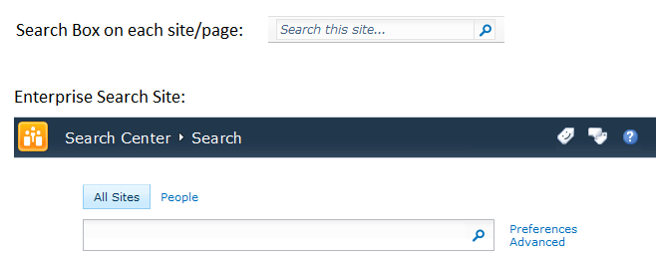
Search
Notes:
SharePoint Search is a robust search engine that uses several components to index all of the content in a multitude of possible resources (a process called crawling) then read that index for pointers to actual data when a user searches for a particular word or phrase. In fact, SharePoint also crawls the SharePoint user profile data to provide a feature that allows you to search for other people in your network by any of their profile properties (such as name, department, title, skills, etc.). The Search engine is so sophisticated, in fact, that it is not unusual for a large company to devote one of the SharePoint engineers in IT to the task of managing the Search engine alone!
CAVEAT: The efforts of SharePoint engineers and administrators can have a great impact on the search results you receive when using the SharePoint search engine. Search is often one of the most highly customized services of a SharePoint enterprise. This course will explore the default configuration of SharePoint Search but keep in mind that the SharePoint search engine at your company may behave differently.
SharePoint provides two methods of searching for content:
Site Search Box: located in the Browse ribbon of every standard SharePoint page, this box provides a quick search mechanism for searching for data (if on a data page) or people (if on a profile page)
Search Site: created and managed by administrators the Enterprise Search Site default home page offers two tabs that search for either data content or people and also provides advanced search boxes for more finely tuned search options.

Slide 20
Search Box on Site/Page
Default scope of results on sites created with the Team Site template: This Site (also includes Profiles for People searches)
Optional additional result scopes can be made available by administrators
No advanced search options
Search process ends on separate results page with a breadcrumb trail back to original site from which you performed the search (by default)
All search results are security trimmed: if you do not have permission to the result item you will not see it in your results
Notes:
The Search box found in the Browse ribbon of SharePoint web pages that have not been customized is a quick tool for performing a search against the SharePoint index. You can search for keywords or phrases to locate content (data) or enter a desired profile property value from the SharePoint User Profiles to receive links to information about another user.
On a SharePoint site that was constructed using the Team Site template the Search Box’s default range of content results, known as a Search Scope, is “This Site”. This means that while SharePoint may actually locate content that matches your search criteria in any of the defined content sources of its index, only those results that come from the site you were visiting when you typed in your search will show up on the search results page. Additional scopes can be created by SharePoint administrators and Site Collection Administrators to give you more possible results.
The Search Box does not offer any Advanced search options that would allow you to specify a particular metadata or profile property to compare your criteria value against. However, it does accept the use of special characters to hone your search:
Double Quotes – search for phrase or proper name ; override word breaking
Plus/Minus – include/exclude multiple criteria
Asterisk – wildcard character to search for all possible values
Results of a search operation will appear on a different web page with options for resubmitting the search for an alternative scope, receiving alerts or subscribing to an RSS feed to be notified about changes to the results due to data activity, creating an association that allows the criteria to be searched form Windows Explorer, as well as page selection at the bottom.

Slide 21
Search Site
Default scope of results: all content sources
Optional additional result scopes can be made available by administrators
Advanced Search options
Requires visiting a separate Search site unless accessed via a Page Viewer web part
All search results are security trimmed: if you do not have permission to the result item you will not see it in your results
Notes:
Some SharePoint enterprises may put up an entire site devoted to performing searches. Often referred to as a Search Center or Search Site, this site would consist of a sophisticated search page that allows advanced searches as well as provides links to prescribed search criteria such as a search for the ten most recently updated documents in SharePoint or the like.
SharePoint 2010 includes a site template called Enterprise Search Site for creating such a Search Center. This site template employs the default enterprise search page that offers users two tabs (by default) for performing searches: All Sites and People. The All Sites tab searches for data content and is scoped to include all of the resources defined in the SharePoint Search service. The People tab searches Profiles for information about users. Both tabs include links for specifying advanced search options to granularly dictate which metadata or profile property you wish your criteria to be compared against.
Because the Search Site is a completely separate site, providing users a quick link to the site is imperative. Site owners and designers may choose to use any of the navigation tools previously discussed in this course or place a Page Viewer web part onto a collaborative page that exposes the Search Site’s default page. When users engage the search box on the Search Site, results are produced on a separate results page that reconstructs the scope and criteria information at the top and lists results in a results web part below, much like the Search Box discussed earlier.
And just like the Search Box, all Search Site results are security trimmed so that users who do not have at least the read permission to the result destination do not receive the destination as a potential result. This is a nice security feature because search results contain not only the hyperlink to the result, but also the result’s title and a brief description of the item. If the item is a document or text file, the description may even include a portion of the first paragraph of the document. Secure data should not be exposed in any degree to users without the appropriate authority.

Slide 22

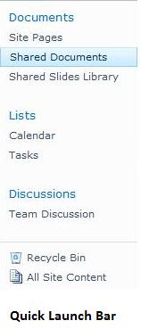
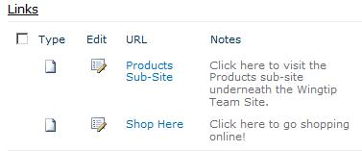
Navigation Links
Links List Web Part
Notes:
Rather than searching, some users are more comfortable following a series of links that follow the data taxonomy (or classification) path, logically arriving at their desired data by category or association. In fact, even search users may turn to navigation links if their search operation fails to provide relevant results and vice versa.
Some navigation tools inherent to SharePoint pages, like the Top Link Bar and Quick Launch, can only be modified by site administrators. That is to say, while they are helpful in linking to other SharePoint or external content, general business users who require a link not found on the Top Link Bar or Quick Launch will need to submit a request to the site administrator to have their desired link added to these features.
Links lists, on the other hand, can be contributed to by users with the necessary Contribute permission to the list. Also, items in a Links list do not necessarily need to be related or contained in the same SharePoint hierarchy. Where a default Quick Launch fails to show links to destinations outside of the immediate site, a Links list can contain items that are hyperlinks to any destination in the world that can be reached through a URL.
Site designers may further ease navigation by adding navigation web parts to the page. These can include site aggregation web parts that roll up links to other content in the same site or display a table of contents for the site as well as web parts that display a more sophisticated and graphical representation of a hyperlink than the Links list.
NOTE: Keep in mind that all of these tools are security trimmed. So if you do not have the necessary permission to at least view the destination, the link to that destination will not be displayed for you.

Slide 23
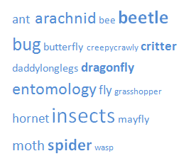
Tagging
Notes:
SharePoint 2010 supports Web 2.0 tagging. Tagging is a method of marking and potentially adding commentary to a web page located either within or outside of SharePoint as well as SharePoint lists and items. Tagging can categorize SharePoint resources beyond the rigid vocabulary and hierarchical limits of the data taxonomy structure enforced by site administrators. In fact, tagging has become so popular that classifying data by collaborative tagging is officially referred to as folksonomy rather than taxonomy.
Tagging can be a personal thing or a public effort. A Tag is nothing more than a key word or very short phrase that a given user associates with a web page, list or item. A user may choose to tag a resource solely for personalization reasons and thus can feel free to create whatever tag name they wish that means something to them. Alternatively, groups of users may agree upon a vocabulary and tag naming standard before creating tags to share with others to help them easily locate a particular resource. A single resource can be tagged multiple times by different tag names.
In SharePoint, tags become metadata about the associated web page and are stored in a list. The list of tags can potentially be arranged into what is called a Tag Cloud if the site designer uses a Tag Cloud web part. This web part will change the font format of each tag name associated with the page based on the number of incidences in which the tag gets used (also called the weight of the tag). For example, the more times users click on a particular tag name, the larger and bolder the tag name’s font becomes in the cloud.
Tags and Tag Clouds are most often employed on blogs and wikis to help organize their informal content pages. But in SharePoint tags can be created on any page and are often employed to steer visitors toward specific important content.

Slide 24


I Like It and Tags & Notes
Notes:
Creating tags on a SharePoint page can be accomplished from the Browse ribbon while viewing the page by using either the I Like It button or the Tags & Notes button. To tag a particular list or library simply visit the list or library itself (not a page bearing the list’s web part), choose the view you like, then engage the Browse ribbon for the page. You can also tag an individual item by visiting its resident list and selecting the item’s checkbox to expose the Items ribbon (or Documents ribbon if on a document library) which offers the same two buttons.
I Like It
This button creates a new tag on the immediate page, list or item and names the tag “I Like It”. You can see a listing of all resources you have tagged and by what tag name in the “Tags and Notes” section of your Profile. In fact, all users with read permission to the public properties of your profile can see and utilize your tags by default. If you do not want other users to know that you have tagged a resource, you can mark your tag as Private.
Tags & Notes
Tags are stored in a list that can then be viewed and managed from the Tags & Notes button. There are two tabs in the Tags & Notes dialog box: Tags and Notes. The Tags tab allows you to add or remove tags from the perspective of a particular resource. You can also remove tags from your Profile in the Tags and Notes section. The Notes tab is used to submit commentary on the resource that other users will be able to see (by default).

Slide 25
DEMO
SharePoint 2010 Search
Notes:
In this demonstration, your instructor will illustrate:
How to perform a basic search.
How to perform an advanced search.
How to perform a people search.
How to add navigation links.
Default navigation and aggregation Web Parts.
How to configure personal tags with I Like It and Tags & Notes.

Slide 26
Agenda
Keeping Informed
Customizing Your Interface
Finding Important Information
Working Offline

Slide 27
Working Offline
Taking individual copies of library items out of SharePoint to store on a non-SharePoint file system
Office 2010 SharePoint Workspace
Notes:
In a perfect IT world, we would all be able to stay connected to our corporate network at all times of the day and night. The SharePoint server would never be unavailable to our desktops and laptops. But the reality, especially for mobile and laptop users, is that there will be occasions when you need to work with SharePoint data without being connected to the SharePoint servers. This practice is referred to as working offline and requires you to be able to take SharePoint data with you before disconnecting from the network.
If you only require a few files from SharePoint and are only planning to read those files, the simple and quick solution may be to simply take copies of those individual files out of their respective libraries and plunk a copy down on your computer’s file system or your mobile device’s memory card. But if you frequently work with multiple libraries worth of items and need to be able to modify those items while away from the network while expecting them to synchronize their changes back to the SharePoint server the next time you connect online, then simply copying the items will be tedious and the automatic synchronization would require another piece of software.
Instead, to work with large volumes of SharePoint data offline and benefit from automatic synchronization when online consider using Office 2010 SharePoint Workspace. The successor to the old Microsoft Office Groove product, SharePoint Workspace is designed to integrate with SharePoint 2010 and provide you an organized platform for pulling, working with, and synchronizing your SharePoint data while offline.

Slide 28
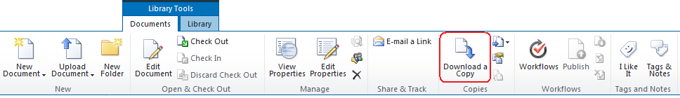
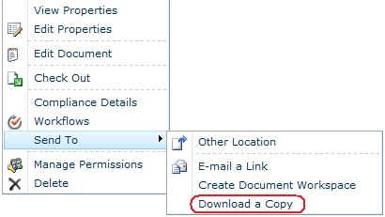
Download a Copy
Notes:
Downloading an individual library item can be accomplished from either the Documents ribbon in Library Tools or from the item’s contextual drop-down menu using the “Download a Copy” choice from the Send To option. Before downloading a copy of the file, consider the following:
Check Out – users who check out a library item for an extended period of time may prevent other users who need to edit the item during their absence from being able to perform their duties so administrators may frown upon offline users who check out items before downloading a copy and going offline just to prevent changes being made to the original item on the SharePoint server during their absence
Server Edits – assuming the item is not checked out by the offline user, the copy that the user downloaded before going offline will be the version of the item at the moment they downloaded it, meaning other users can edit the copy on the SharePoint server while the offline user is away making the offline copy obsolete without the offline user knowing it
Client Edits – any changes the offline user makes to their downloaded copy of the item, known as their local copy, will not be seen by SharePoint users who visit the original item in the SharePoint library
No Synchronization – the SharePoint server does not keep any relationship with the offline downloaded copy of the item so changes made at the server do not automatically update the downloaded copy the next time the offline user connects…nor do any changes made to the downloaded copy while the offline user was away make their way back to the library item on the SharePoint server
Overwrites – when an offline user reconnects to the SharePoint server, if they’ve made changes to their local copy of the item they will need to decide whether to upload that file into the library as a new item or overwrite the existing (original) library item of the same name…if other users made changes to the library item during the offline user’s absence and the offline user overwrites the library item those users’ changes will be lost unless version control is enabled on the library.

Slide 29
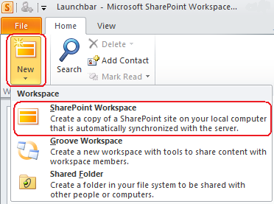
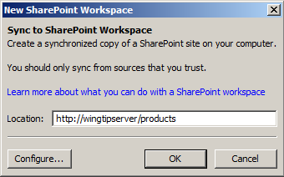
SharePoint Workspace
Notes:
SharePoint Workspace is an application available in the Office 2010 suite that gives users the ability to create a synchronized copy of an entire SharePoint site or just select lists and libraries from a SharePoint site on their client computer (pending space requirements, of course). This product is a sophisticated application that could fill an entire course by itself with topics such as Account Configuration, Backstage, Views, and more that fall beyond the scope of this module about personalizing SharePoint.
Suffice it to say that if you are a user on the go who utilizes a laptop as your client computer, SharePoint Workspace 2010 may be a viable solution for you to keep automatically synchronized copies of entire lists and libraries on your laptop for use offline. SharePoint Workspace 2010 will manage the synchronization of your changes back to the SharePoint server when you next connect to the corporate network. It will also notify you of changes made to those items on the server that it has been configured to download and give you the opportunity to decide how to resolve any edit conflicts. Edit conflicts arise when you, the offline user, have edited your item in a different fashion than one of the other SharePoint users who edited the original item located on the SharePoint server while you were away.

Slide 30
DEMO
Working with SharePoint Offline
Notes:
In this demonstration, your instructor will illustrate:
How to download a library item from the Documents tab in the ribbon.
How to download a library item from the item’s contextual drop-down menu.
How to connect SharePoint Workspace to a SharePoint site and configure which library to download.

Slide 31
Summary
Keeping Informed
Customizing Your Interface
Finding Important Information
Working Offline
Notes:
In this module, you learned to personalize your SharePoint experience. We illustrated different notification mechanisms you can employ to keep up with changes that occur in your favorite sites and lists then learn how to customize your interface to best suit your work style. We’ll also take a look at how you can find important information in SharePoint and what you can do when you need to take SharePoint data with you while away from the SharePoint server.
In this module, you explored various methods of being notified by SharePoint about changing data and how you can customize your interface to improve your productivity. You also learned methods for locating relevant data in SharePoint and how to work with that SharePoint data when you are offline from the SharePoint server.
This is the concluding Module of the SharePoint 2010 For End Users course which covered the following topics:
Mod. 1 "Introducing SharePoint”
Mod. 2 "Lists and Libraries“
Mod. 3 "Document Libraries and Form Libraries“
Mod. 4 "Workspaces“
Mod. 5 "SharePoint Social Networking“
Mod. 6 "Personalizing SharePoint”

